Slide 1
Parents’ Online Safety Event
February 2025

Slide 2
The online world can be fabulous. There are many wonderful uses for the internet.
However once your child has access to the internet they have access to the world! Including:
    Access to friends and strangers in any country in the world of any age.
    Porn/indecent images/videos, nudity, sexting
    Inappropriate content
    Videos of absolutely anything and everything – sex, violence, abuse!
    Social media-pressures of looking perfect, being rich etc.
    Cyber bullying/online harassment/sexual harassment/trolling etc
    Access to the dark web

Slide 3
Issues that can arise due to screen addiction:
Aggressive behaviour when asked to switch off console
Sleep issues – leading to being tired in the morning
Easily bored
Lack of concentration
Higher issues with converting short term to long term memory (how we learn!)
Increase in children avoiding other activities/saying ‘no’
Less active – can lead to obesity
Problems in social-emotional development (depression, and anxiety are common)
It can impair emotional comprehension, promote aggressive behavior, and hinder social and emotional competence.

Slide 4
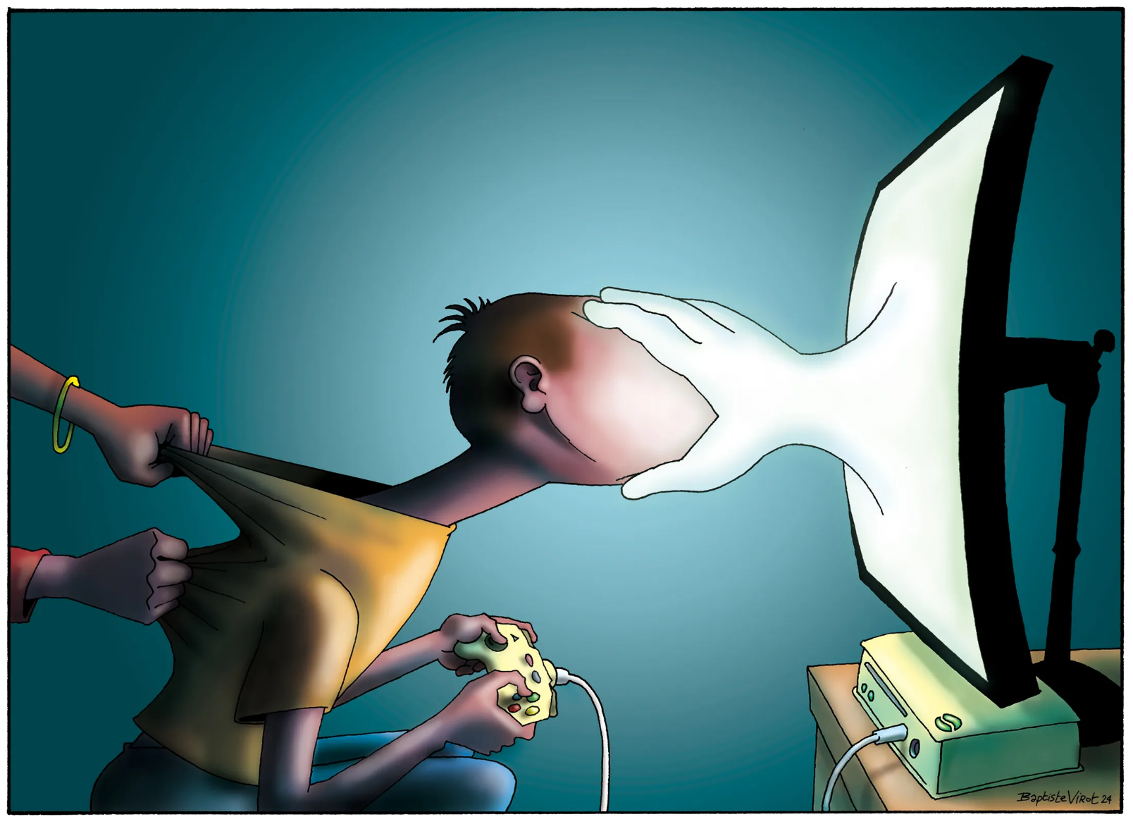
Kids hooked on video games prompt a flurry of law suits.

Slide 5
National Statistics
Almost 9 in 10 children (89%) aged 10 to 13 years said they went online every day.
While the majority of children told us they only spoke to or exchanged messages with people online who they knew in person, around one in six children (33%) aged 10 to 15 years spoke with someone they had never met.
An estimated 1 in 50 children (7%) said that they spoke to or messaged someone online in the previous 12 months who they thought was their age but later found out were much older.
An estimated 5% of children aged 10 to 13 years met up in person with someone they had only spoken to online (equivalent to 212,000 children) in the previous 12 months.
Around 1 in 10 children (11%) aged 13 to 15 years reported receiving a sexual message, while 1 in 100 reported sending a sexual message, in the previous 12 months.
Girls aged 13 to 15 years were significantly more likely to report receiving sexual messages than boys (16% compared with 6%) in the previous 12 months.
The majority of parents or guardians of children aged 10 to 15 years (64%) had some sort of rules about the length of time and when their children can go online.

Slide 6
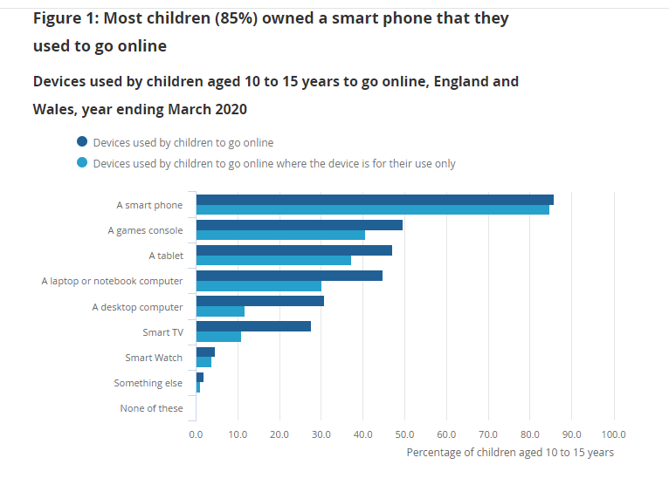
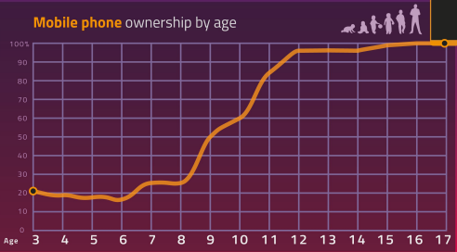

Slide 7
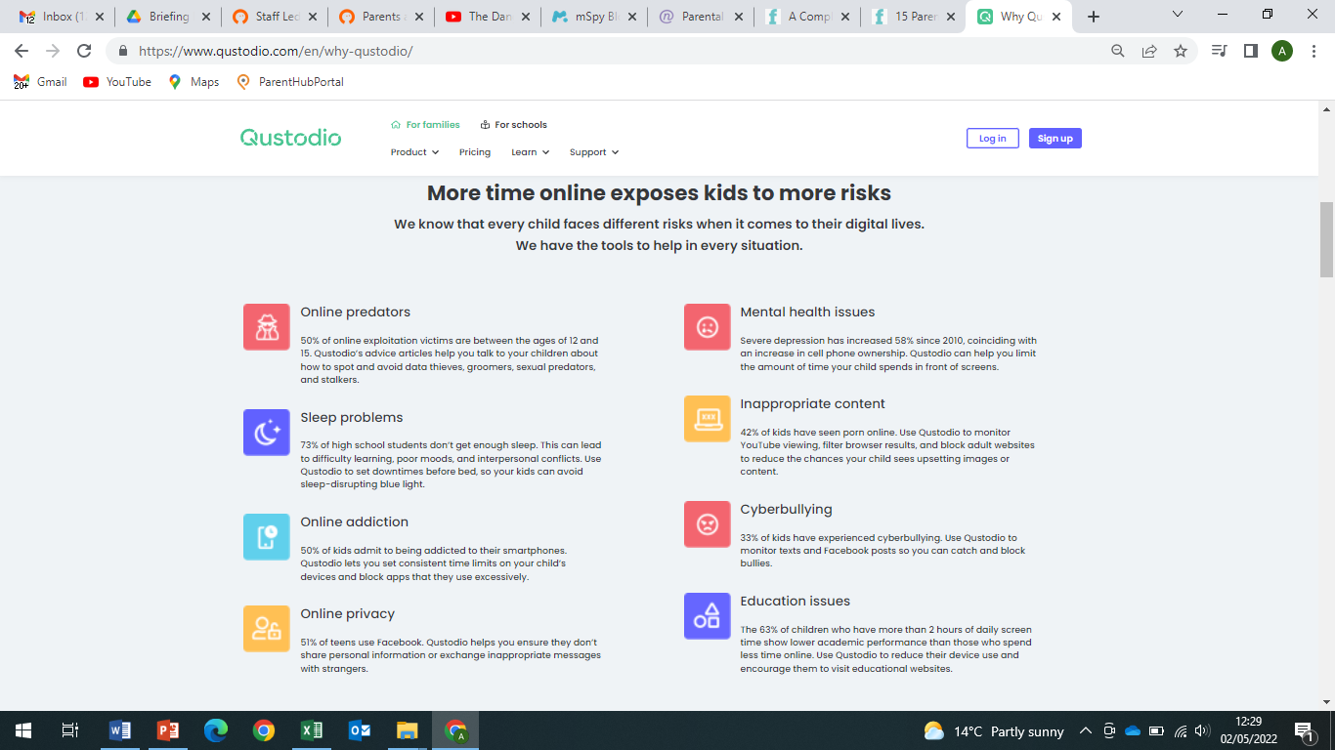

Slide 8
Our kids!
91% of our children said they had access to the internet
37% have mobile phones (66% in yr 5/6)
44% said their parents checked their internet usage. Only 9% of year 5/6 said their parents checked their internet usage- the majority of pupils said that their parents trusted them and didn’t need to check.
37% of pupils said they had met and spoken to strangers online (73% of yr 5/6s).
49% of pupils said they had seen or heard something online that they didn’t like or scared them.
8% said they had been a victim of online bullying.

Slide 9
Neurodevelopment
https://www.youtube.com/watch?v=ndOB-vXwXxM
https://www.youtube.com/watch?v=cK6p8VyyvCs

Slide 10
Your child’s first phone
We recommend that your child doesn’t have their own phone until they go to secondary school.
https://www.vodafone.co.uk/help-and-information/nspcc-phone-safety-toolkit
T
Talking about safe phone use
R
Recognising rights to safety online
U
Using online safety and wellbeing tools
S
Support when facing challenges online
T
Talking about online safety going forward

Slide 11
When you decide to give your child a phone:
Be prepared for it to become an addiction.
Consider which phone you will get them- do they need an iphone16? Older phones can be used for phoning, texting and internet but won’t be able to download apps i.e. iphone 8.
Set parental controls on your child’s phone (make an appointment with us to help you if you need).
Set time limits- how long do you want your child on their phone for?
Use age appropriate apps – they should not have social media in primary school.
Monitor your child’s phone and teach them how to use it safely, this includes how to text other people.

Slide 12
Keeping Children Safe Online
NSPCC
https://www.nspcc.org.uk/keeping-children-safe/online-safety/
Childnet International
https://www.childnet.com/parents-and-carers/
What if something goes wrong?
https://www.childnet.com/parents-and-carers/get-help/

Slide 13
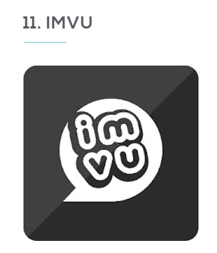
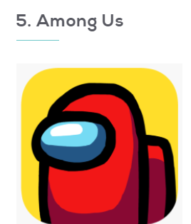
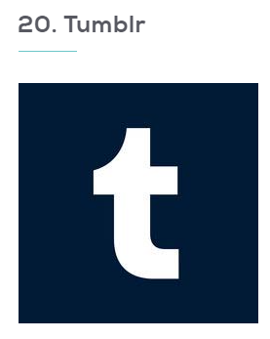
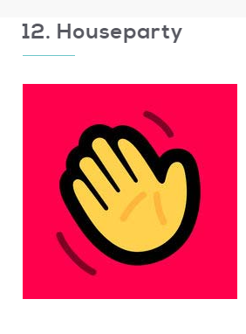
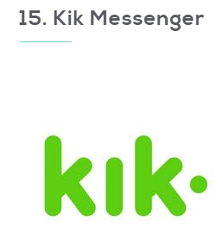
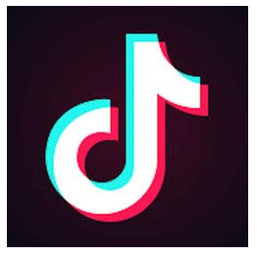
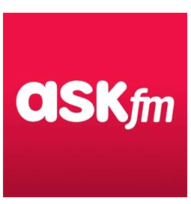
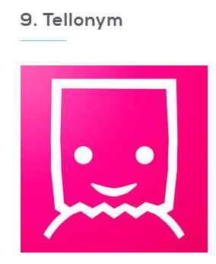
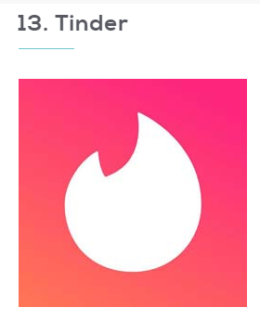
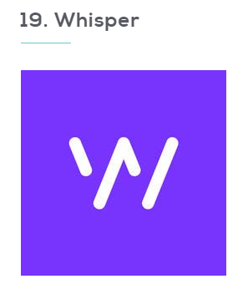
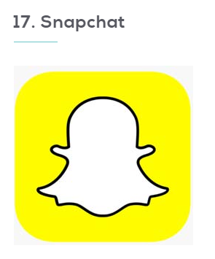
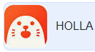
Virtual chat rooms” that you visit with 3-D avatars you create is definitely not for kids, and is full of varying levels of suggestive, inappropriate, and downright explicit content.
Sexist, sexual, degrading, racist, homophobic content
Online game - cyber bullying, suicide.
Anonymous messaging app – cyber bullying
Messages delete as soon as read- cyber bullying & sexting
Dating app
Videos with random people across the globe.

Slide 14
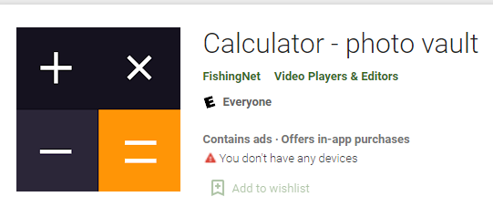
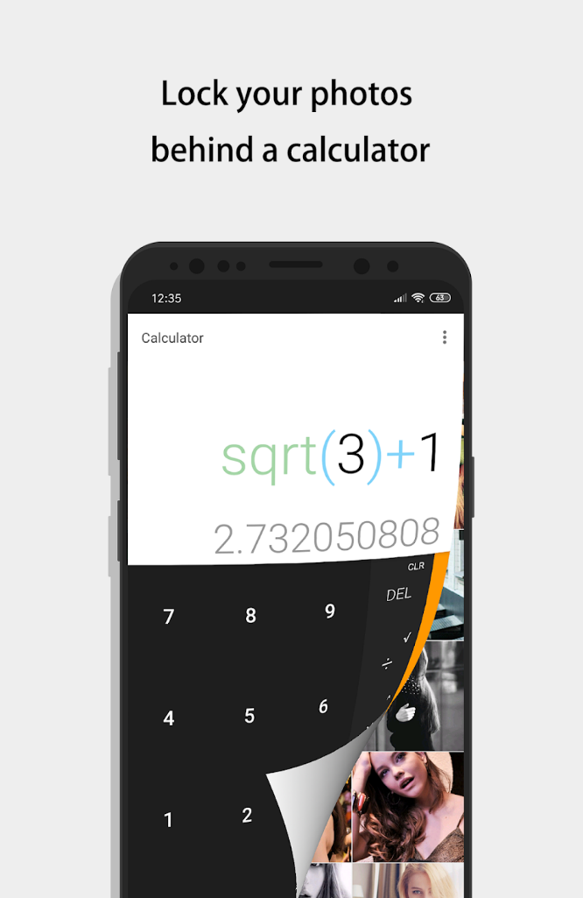
Children can hide their apps!
TIK TOK
Experimental research showed that after 5-6 hours on the platform, almost 1 in 2 videos were mental health-related and potentially harmful.
There was an even faster “rabbit hole” effect when researchers manually rewatched mental health videos- Between 3 and 20 minutes into our manual research, more than half of the videos in the ‘For You’ feed were related to mental health struggles with multiple recommended videos in a single hour romanticizing, normalizing or encouraging suicide.
You tube shorts, Instagram.

Slide 15

Roblox is not completely safe for kids because the gaming platform can expose children to cyberbullying, scammers, predators, inappropriate content, malware and viruses.
There are several reasons why Roblox is not entirely safe for children, such as the fact that its content is user-generated.
OUR CHILDREN SAID:
      “Other children sometimes aren’t that nice on Roblox. They can say mean things and swear. I don’t tell my mum because she won’t let me play it anymore.”
      “I love Roblox. I have lots of friends on Roblox. Some are mean and then I tell them to go away.”
      “There is a game about killing pigs on a roller coaster. It’s really gruesome. I don’t think my parents know about that game but there are other good games as well that are ok.”
      “I like playing with my friends. Sometimes people try and be my friend but I say no if I don’t know them.”
      “I have heard people say bad things but I don’t say them.”
https://swgfl.org.uk/resources/checklists/roblox/

Slide 16
AI
Can be fantastic!
School are working on an AI policy and looking into how we can teach and use AI safely. More information will be available on our school website when the documents are completed.

Slide 17
AI can also be used negatively-
New trend for teenage boys– ‘Cloth off’, ‘ReTouch Me’ etc.
Be aware of chat bots- even innocent children’s chat bots. Within 8 messages can go to explicit content where chat bots are saying and asking children/users to do inappropriate things.
- One chat bot- after saying hi, some one jumps out of a window and the chat bot was writing ‘die b***’.

Slide 18
Porn
Half of children online have accidently or on purpose seen porn.
"I’ve been watching a lot of porn recently – it’s become a bit of an addiction. I think about sex all the time.
Whenever I see a girl I fancy I think about how it would be to sleep with them and do the stuff I’ve seen in porn films.
I can’t help it even though I know it’s inappropriate."
Boy, aged 12
Sextortion
Growing concern mainly targeting young boys

Slide 19
Get an App to monitor your child’s online use.
Filter adult content in real-time
Block pornography
Send alerts of online activity
Help you manage screen time
Offer social media protection
YouTube monitoring and management
Provide you with peace of mind
Monitor text messages/apps
Remove safari (or other internet app from their phone if they don’t need it).
Download youtube kids-

Slide 20
Best Apps
BARK - https://www.bark.us/how/ £13 a month!
- Phone Tracker – 12 months £8.74 per month
Net Nanny - £50 per year (5 devices)
Qustodio - Plans start at £39.95 (£3.33 per month) (5 devices)
Famisafe – Monthly cost £3.50
Kaspersky Safe Kids – Says free but £14.99 per year
Free:
YouTubeKIDS – Free but is not 100% safe.

Slide 21
How to set security on your child’s phone for free
Iphone:
Settings/privacy&security/sensitive content warning (turn on/off)- then choose which app i.e. airdrop, messages etc.
How to limit screen time –
  Step 1: Settings> Screen time> Content & Privacy Restrictions> Content Restrictions', then tap 'Web Content'. Choose Unrestricted Access, Limit Adult Websites, or Allowed Websites Only.
settings/Apple ID/familysharing/
  Invite your child
  You can have access to your child’s location, browser history, app usage etc if you want to set this up.
  There is lots of further information on your phones in settings/privacy and security/sensitive content warning/view safety resources/additional resources (for grown ups/children under 13/over 13).
    You can also report online child sexual abuse here.

Slide 22
Ensure children have to ask for permission before downloading apps
1. Create a Family Sharing Group
  Open Settings on your device.
  Tap your name and select Family Sharing.
  Follow the prompts to invite family members. Make sure your child’s account is part of this group.
2 .Enable “Ask to Buy”
  Go to Settings > Family Sharing.
  Select your child’s account.
  Turn on the Ask to Buy toggle.
3 .Approve or Decline Requests
  When your child requests an app, a notification will appear on the parent’s device.
  Tap the notification to view details about the app.
  Choose to approve or decline the request.

Slide 23
Set your child’s phone up on your family and friends
  We must teach our children-
  Monitor conversations-read your child’s text messages with them.
  Help them respond to text messages- this skill must be taught!
  If you build up this communication and trust, your children will trust you if something bad happened on their phone.
  Messages on games and phones causes many friendship issues inside and outside school

Slide 24
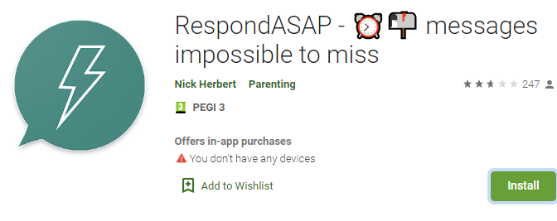
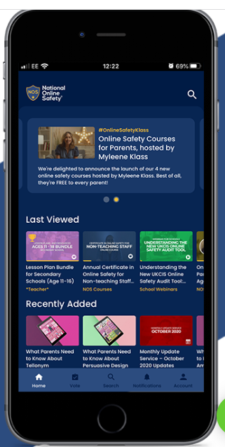
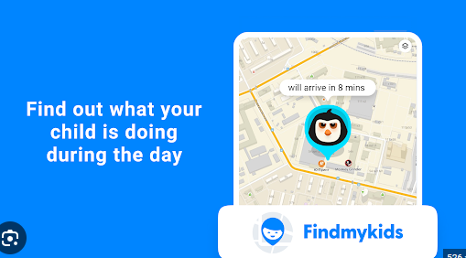

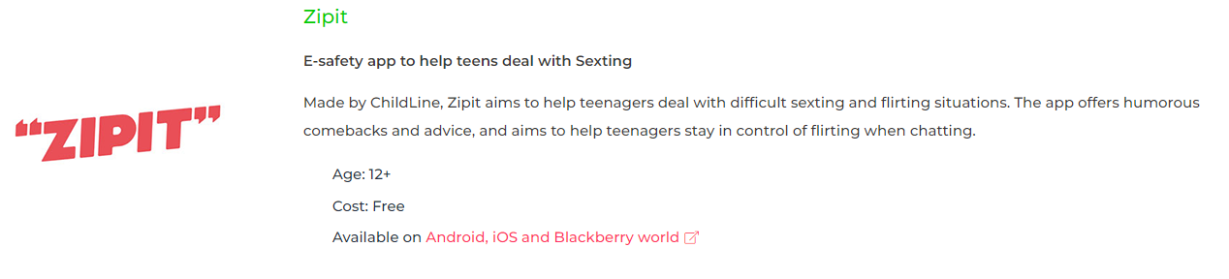
If children don’t reply instantly blocks phone to all but you.
National Online Safety App- tips, info and latest news.
Find my phone – free!

Slide 25
Conclusion
Talk to your child.
Keep an open monologue
Check your child’s phone with them.
Don’t punish them for other people’s mistakes
Use age appropriate apps
Limit screen time
Have a family agreement

Slide 26
Next Steps for Parents
1. Sit down with your child and find out which apps they are using, how they work, and whether they have experienced any issues on them, such as cyberbullying or contact from strangers.
2. Look into apps and products that help you monitor your child online.
If your main concerns are web browsing and social media safety, we recommend Qustodio. They provide a comprehensive dashboard to help you monitor your child's online activity. Their premium subscription allows you to track kids' location, block certain games and apps, monitor calls and text messages, and more. Browse Qustodio's offerings.
If your main concern is filtering web content and setting internet time limits for multiple kids and/or devices, Net Nanny is a great option. The software automatically filters web content for each user based on whether they fit the Child, Pre-Teen, Teen, or Adult profile. It allows you to "mask" profanity on web pages. It also makes it easy to prevent web access during homework time or bedtime. Browse Net Nanny's offerings.
Tips for Protecting Your Child Online
You can set up age limits on your child's device. The 2013 Pew Research Center survey found that nearly 40 percent of teens say that they have lied about their age to gain access to a site or create an account, so restricting kids' access to apps by age rating is a wise move. You can't join every site or app and monitor your child's every move online; teens will always find a new platform that their parents don't know about yet. Rather than hovering or completely barring your child from downloading every social media app, sit down and go over some general rules to keep him smart and safe online.
Tell your child to let you know if someone is hurting her or making her feel uncomfortable online, even if the person is acting anonymously. Use the Cyberbullying Research Center's "Questions Parents Should Ask Their Children About Technology" to guide your discussion. Our printable anti-bullying pledge and parent/child online agreement are also useful tools.
Make a rule that your child must ask for permission before downloading any apps (there is setting on the family share where children must ask permission to download apps) — even free ones — just so you're aware of them. When your child wants to join a new social media platform, go through the security settings together to choose the ones you're most comfortable with. Advise your child not to share passwords with anyone, including best friends, boyfriends, or girlfriends.

